Slide 1
Component level design
Management of Software Systems

Slide 2
Component level design
Introduction
The software component
Designing class based components
Designing conventional components

Slide 3
The software component
The software component is a modular building block for computer software
It is a modular, deployable, and replaceable part of a system that encapsulates implementation and exposes a set of interfaces
A component communicates and collaborates with
Other components
Entities outside the boundaries of the system
Three different views of a component
An object oriented view
A conventional view
A process related view

Slide 4
Object oriented view
A component is viewed as a set of one or more collaborating classes
Each problem domain (i.e., analysis) class and infrastructure (i.e., design) class is elaborated to identify all attributes and operations that apply to its implementation
This also involves defining the interfaces that enable classes to communicate and collaborate
This elaboration activity is applied to every component defined as part of the architectural design
Once this is completed, the following steps are performed
Provide further elaboration of each attribute, operation and interface
Specify the data structure appropriate for each attribute
Design the algorithmic detail required to implement the processing logic associated with each operation
Design the mechanisms required to implement the interface to include the messaging that occurs between objects

Slide 5
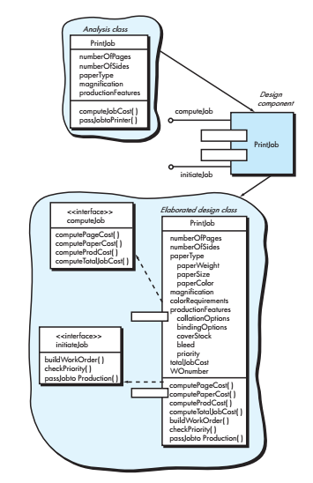
Consider software to be built for a sophisticated print shop. The intent of the software is to collect the customer’s requirements, cost a print job, and then pass the job on to aproduction facility. During requirements engineering, an analysis class called PrintJob was derived. The attributes and operations defined during analysis are noted at the top of Figure. During architectural design, PrintJob is defined as a component within the software architecture and is represented using the shorthand UML notation. PrintJob has two interfaces, computeJob, which has costing capability, and initiateJob, which passes the job to the production facility.
Component-level design begins at this point. The details of the component PrintJob must be elaborated to provide sufficient information to guide implementation. The original analysis class is elaborated to flesh out all attributes and operations required to implement the class as the component PrintJob. Referring to the lower right portion of Figure, the elaborated design class PrintJob contains more detailed attribute information as well as an expanded description of operations required to implement the component. The interfaces computeJob and initiateJob imply communication and collaboration with other components (not shown here). For example, the operation computePageCost() (part of the computeJob interface) might collaborate with a PricingTable component that contains job pricing information. The checkPriority() operation (part of the initiateJob interface) might collaborate with a JobQueue component to determine the types and priorities of jobs currently awaiting production.

Slide 6
Conventional view
A component is viewed as a functional element (ie., a module) of a program that it incorporates
The processing logic
The internal data structures that are required to implement the processing logic
An interface that enables the component to be invoked and data to be passed to it
A component serves one of the following roles
A control component that coordinates the invocation of all other problem domain components
A problem domain component that implements a complete or partial function that is required by the customer
An infrastructure component that is responsible for functions that support the processing required in the problem domain

Slide 7
Conventional view (contd.)
Conventional software components are derived from the data flow diagrams (DFDs) in the analysis mode
Each transform bubble (ie. Module) represented at the lowest levels of the DFD is mapped into a module hierarchy
Control components reside near the top
Problem domain components and infrastructure components migrate toward the bottom
Functional independence is strived for between the transforms
Once this is completed, the following steps are performed for each transform
Define the interface for the transform (the order, number and types of the parameters)
Define the data structures used internally by the transform
Design the algorithm used by the transform (using a stepwise refinement approach)

Slide 8
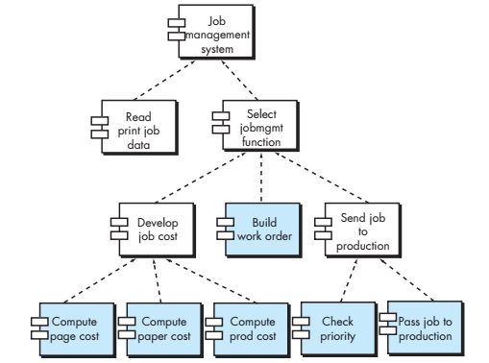
A hierarchical architecture is used here. Each box represents a software component. Each operation is represented as a separate module that is invoked as shown in the figure. Other modules are used to control processing and are therefore control components. During component-level design, each module in Figure is elaborated. The module interface is defined explicitly. That is, each data or control object that flows across the interface is represented. The data structures that are used internal to the module are defined. The algorithm that allows the module to accomplish its intended function is designed using a stepwise refinement approach. The behavior of the module is sometimes represented using a state diagram.

Slide 9
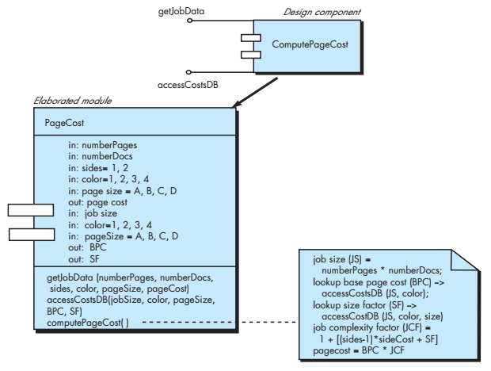
Figure represents the component-level design using a modified UML notation. The ComputePageCost module accesses data by invoking the module getJobData, which allows all relevant data to be passed to the component, and a database interface, accessCostsDB, which enables the module to access a database that contains all printing costs. As design continues, the ComputePageCost module is elaborated to provide algorithm detail and interface detail. Algorithm detail can be represented using the pseudocode text shown in the figure or with a UML activity diagram. The interfaces are represented as a collection of input and output data objects or items. Design elaboration continues until sufficient detail is provided to guide construction of the component

Slide 10
Process related view
Emphasis is placed on building systems from existing components maintianed in a library rather than creating each component from scratch
As the software architecture is formulated, components are selected from the library and used to populate the architectur
Because the components in the library have been created with reuse in mind, each contains the following
A complete description of their interface
The functions they perform
The communication and collaboration they require

Slide 11
Designing class based components

Slide 12
Component level design principles
Open-closed principle
A module or component should be open for extension but closed for modification
The designer should specify the component in a way that allows it to be extended without the need to make internal code or design modifications to the existing parts of the component
Liskov substitution principle
Sub-classes should be substitutable for their base classes
A component that uses a base class should continue to function properly if a subclass of the base class is passed to the component instead
Dependency inversion principle
Depend on abstractions , do not depend on concretions
The more a component depends on other concrete components (rather than on the interfaces) the more difficult it will be to extend
Interface segregation principle
Many client specific interfaces are better than one general purpose interface
Only those operations that are relevant to a particular category of clients should be specified in the interface

Slide 13
Component packaging principles
Release reuse equivalency principle
The granularity of reuse is the granularity of release
Group the reusable classes into packages that can be managed, upgraded, and controlled as new versions are created.
Common closure principle
Classes that change together belong together
Classes should be packaged cohesively: they should address the same functional or behavioral area on the assumption that if one class experiences a change then they all will experience a change
Common reuse principle
Classes that aren’t reused together should not be grouped together
Classes that are grouped together may go through unnecessary integration and testing when they have experienced no changes but when other classes in the package have been upgraded

Slide 14
Component level design guidelines
Components
Establish naming conventions for components that are specified as part of the architectural model and then refined and elaborated as part of the component level model
Obtain architectural component names from the problem domain and ensure that they have meaning to all stakeholders who view the architectural model (eg. Calculator)
Use infrastructure component names that reflect their implementation (e.g. stack)
Dependencies and inheritance in UML
Model any dependencies from left to right and inheritance from top (base class) to bottom (derived classes)
Consider modeling any component dependencies as interfaces rather than representing them as a direct component-to-component dependency

Slide 15
Cohesion
Cohesion is the “single mindedness” of a component
It implies that a component or class encapsulates only attributes and operations that are closely related to one another and to the class or component itself
The objective is to keep cohesion as high as possible

Slide 16
The kinds of Cohesion
The kinds of cohesion can be ranked in order from highest (best) to lowest (worst)
Functional
A module performs one and only one computation and then returns a result
Layer
A higher layer component accesses the services of a lower layer component
Communicational
All operations that access the same data are defined within one class

Slide 17
The kinds of Cohesion
The kinds of cohesion can be ranked in order from highest (best) to lowest (worst)
Sequential
Components or operations are grouped in a manner that allows the first to provide input to the next and son on in-order to implement a sequence of operations
Procedural
Components or operations are grouped in a manner that allows one to be invoked immediately after the preceding one was invoked, even when no data passed between them
Temporal
Operations are grouped to perform a specific behavior or establish a certain state such as program start-up or when an error is detected
Utility
Components, classes, or operations are grouped within the same category because of similar general functions but are otherwise unrelated to each other

Slide 18
Coupling
As the amount of communication and collaboration increases between operations and classes, the complexity of the computer based system also increases
As complexity rises, the difficulty of implementing, testing, and maintaining software also increases
Coupling is a qualitative measure of the degree to which operations and classes are connected to one another
The objective is to keep coupling as low as possible

Slide 19
The kinds of coupling ranked in order from lowest (best) to highest (worst)
Data coupling
Operation A() passes one or more atomic data operands to operation B(); the less the number of operands, the lower the level of coupling
Stamp coupling
Control coupling
Common coupling
Content coupling
A whole data structure or class instantiation is passed as a parameter to an operation
Operation A() invokes operation B() and passes a control flag to B that directs logical flow within B()
Consequently, a change in B() can require a change to be made to the meaning of the control flag passed by A(), otherwise an error may result
A number of components all make use of a global variable, which can lead to uncontrolled error propagation and unforeseen side effects
One component secretly modifies data that is stored internally in another component

Slide 20
Other kinds of Coupling (unranked)
Subroutine call coupling
When one operation is invoked it invokes other operation within side of it
Type use coupling
Component A uses a data type defined in component B, such as for an instance variable or a local variable declaration
If when the type of definition changes, every component that declares a variable of that data type must also change
Inclusion or import coupling
Component A imports or includes the contents of component B
External coupling
A component communicates or collaborates with infrastructure components that are entities external to the software (e.g., operating system functions, data base functions, networking functions)

Slide 21
Steps for component level design
1. Identify all design classes that correspond to the problem domain as defined in the analysis model and architectural model
2. Identify all design classes that correspond to the infrastructure domain
These classes are usually not present in the analysis or architectural models
These classes include GUI components, operating system components, data management components, networking components etc.

Slide 22
Steps for component level design (contd.)
3 .Elaborate all design classes that are not acquired as reusable components
Specify message details (i.e., structure) when classes and components collaborate
Identify appropriate interfaces (e.g. abstract classes) for each component
Elaborate attributes and define data types and data structures required to implement them (usually in the planned implementation language)
Describe processing flow within each operation in detail by means of pseudo code or UML activity diagrams
4. Describe persistent data sources (databases and files) and identify the classes required to manage them

Slide 23
Steps for component level design (Contd.)
5. Develop and elaborate behavioral representations for a class or component
This can be done by elaborating the UML state diagrams created for the analysis model and by examining all use cases that are relevant to the design class
6. Elaborate deployment diagrams to provide additional implementation detail
Illustrate the location of key packages or classes of components in a system by using class instances and designating specific hardware and operating system environments

Slide 24
Steps for component level design (Contd.)
7. Factor every component level design representation and always consider alternatives
Experienced designers consider all (or most) of the alternative design solutions before settling on the final design model
The final decision can be made by using established design principles and guidelines

Slide 25


